Slide 1

Presentation title: Wireless Local Area Network(WLAN)
Course title: Wireless Communication
Course code:ICT-4201
Presented by:
Md. Lutfor Rahaman
ID: IT-21047
session:2020-21
Dept. of ict, MBSTU
Supervised by:
Dr. Nazrul Islam
Associate Professor
Dept. of ICT
MBSTU

Slide 2
Discussion topic:
1.What is WLAN
2. How a Wireless Local Area Network (WLAN) works
3. WLAN Architecture
4.History of WLAN
5.Types of WLAN
6. Advantages
7. Disadvanteges

Slide 3
What is WLAN
A wireless LAN (WLAN) is a wireless computer network that links two or more devices using wireless communication to form a local area network (LAN) within a limited area such as a home, school, computer laboratory, campus, or office building. This gives users the ability to move around within the area and remain connected to the network. Through a gateway, a WLAN can also provide a connection to the wider Internet. Wifi is an example of WLAN.

Slide 4
What is WLAN
While a WLAN may look different than a traditional LAN, it functions the same way. New devices are typically added and configured using DHCP. They can communicate with other devices on the network the same way they would on a wired network. The primary difference is how the data is transmitted. In a LAN, data is transmitted over physical cables in a series of Ethernet packets. In a WLAN, packets are transmitted over the air.

Slide 5
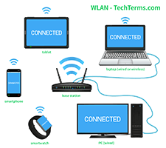
How a Wireless Local Area Network (WLAN) works
Steps:
1. Wi-Fi router (Access Point) sends out wireless signals through the air.
2. Your device connects to that signal using its built-in Wi-Fi antenna.
3. The router (AP) then passes that data to the internet through cables.
4. The internet sends back data (like a web page or video) to your router.
5. All communication happens using radio waves — like invisible signals in the air.
6. To avoid confusion, Wi-Fi devices take turns sending data.

Slide 6
WLAN Architecture
Components in Wireless LAN architecture as per IEEE standards are as follows:
Stations: Stations consist of all the equipment that is used to connect all wireless LANs. Each station has a wireless network controller.
Base Service Set(BSS): It is a group of stations communicating at the physical layer.
Extended Service Set(ESS): It is a group of connected Base Service Set(BSS).
Distribution Service (DS): It connects all Extended Service Set(ESS).

Slide 7
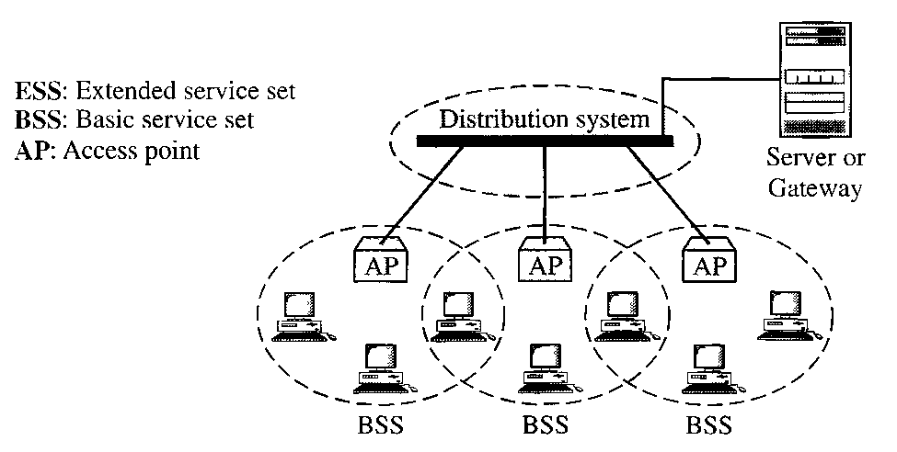
Architecture WLAN

Slide 8
History of WLAN
Early years and foundations
1971: Norman Abramson, a professor at the University of Hawaii, created the world's first wireless computer communication network, ALOHAnet.
1979: Gfeller and Bapst published a paper on an experimental WLAN using diffused infrared communication.
1980s: The advent of laptop computers created a need for mobility, driving the development of wireless networking solutions to connect devices to the internet without wires.
1991: The first IEEE workshop on Wireless LANs was held, and the first IEEE working group was founded to create the technical basics for the new standard.

Slide 9
Types of WLAN
The main types of WLAN are:
1. Infrastructure Mode.
2. Peer-to-peer.
3. Bridge
Infrastructure
Most Wi-Fi networks are deployed in infrastructure mode. In infrastructure mode, wireless clients, such as laptops and smartphones, connect to the WAP to join the network. The WAP usually has a wired network ,connection and may have permanent wireless connections to other WAPs.WAPs are usually fixed and provide service to their client nodes within range. Some networks will have multiple WAPs using the same SSID and security arrangement. In that case, connecting to any WAP on that network joins the client to the network, and the client software will try to choose the WAP that gives the best service, such as the WAP with the strongest signal.

Slide 10
Types of WLAN
Peer-to-peer
An ad hoc network is a network where stations communicate only peer-to-peer (P2P). There is no base and no one gives permission to talk. This is accomplished using the Independent Basic Service Set (IBSS). A Wi-Fi Direct network is a different type of wireless network where stations communicate peer-to-peer. In a peer-to-peer network wireless devices within range of each other can discover and communicate directly without involving central access points.

Slide 11
Types of WLAN
Bridge
A bridge can be used to connect networks, typically of different types. A wireless Ethernet bridge allows the connection of devices on a wired Ethernet network to a wireless network. The bridge acts as the connection point to the wireless LAN.

Slide 12
Advantages of WLAN
Installation speed and simplicity.
Installation flexibility.
Reduced cost of ownership.
Reliability.
Mobility.
Robustness.
The range of a WLAN can easily be extended by adding one or more repeaters.

Slide 13
Disadvantages of WLAN
Wireless networks are naturally less secure than wired networks. Any wireless device can attempt to connect to a WLAN, so it is important to limit access to the network if security is a concern.
Slower bandwidth.
Less capacity.
Wireless networks cost four times more than wired network cards.
Wireless devices emit low levels of RF which can be harmful to our health.

Slide 14


